Slide 1

Data Visualization
Submitted by :
Shreya Singh

Slide 2



Table of Contents
Data Source
Purpose
Tableau Story

Slide 3




Aid Worker Security
AWSD- The Aid Worker Security Database (AWSD) records major incidents of violence against aid workers, with incident reports from 1997 through the present. Initiated in 2005, to date the AWSD remains the sole comprehensive global source of this data, providing the evidence base for analysis of the changing security environment for civilian aid operations.

Slide 4
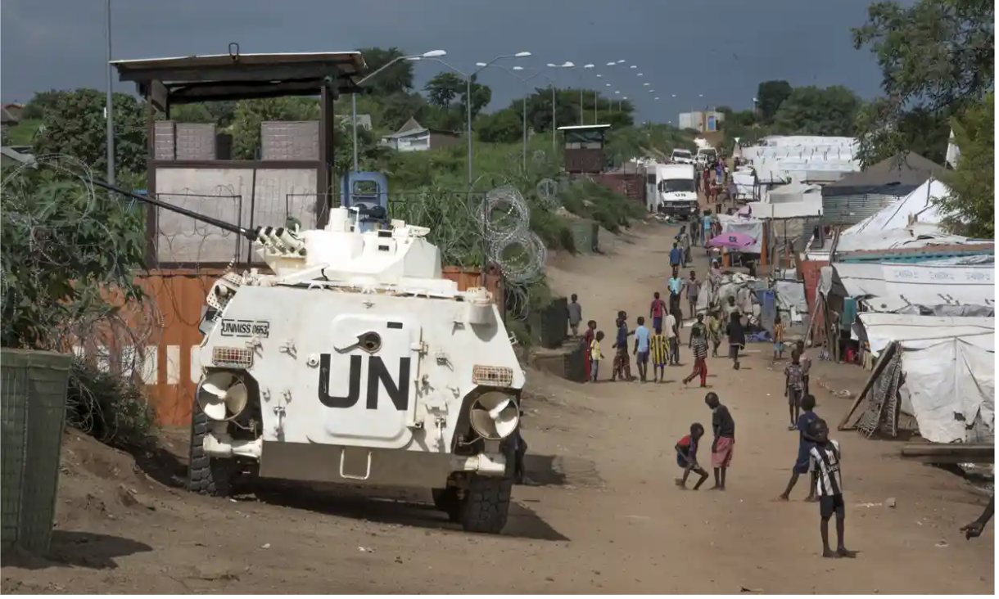
Purpose
High insecurity for aid workers can significantly reduce access to a needy population and limit both the amount and quality of aid provided. To better understand and measure this serious implication of aid worker attacks, the research team is therefore increasing documentation of the impacts this insecurity It would help govt officials and NGOs to ensure the security of the aid workers working for the humanitarian grounds.

Slide 5
No of incidents recorded over the years and the top-most countries recorded these incidents

Slide 6
Attack Context , types of incidents , and its distribution.

Slide 7
On a click- changes the numbers , resulting in change in the visualization !!!!!

Slide 8
On a click- changes the numbers , resulting in change in the visualization !!!!!

Slide 9

References: Inspiration from Lani He Data Downloaded from : https://aidworkersecurity.org/
Data Visualization , it just not represents the data , it can act as a tool which brings awareness among many who don’t understand data / technical terms.
We have a saying : Pen is mightier than the sword , data visualization is one a kind!!!!

Slide 10


Thank You

